Slide 1
Risk Matrix
Purpose
quantify the level of risk existing in a technology
ensure that all milestones are focused on reducing risk
identify those milestones most important to reducing risk
communicate the reduction in risk versus time and cost
General Approach
identify major technical risk areas and failure modes by technology component
assign an initial absolute level to each risk
lay out a milestone schedule
assign a level of risk reduction associated with successful completion of milestone
track risk reduction versus time and expenditures

Slide 2
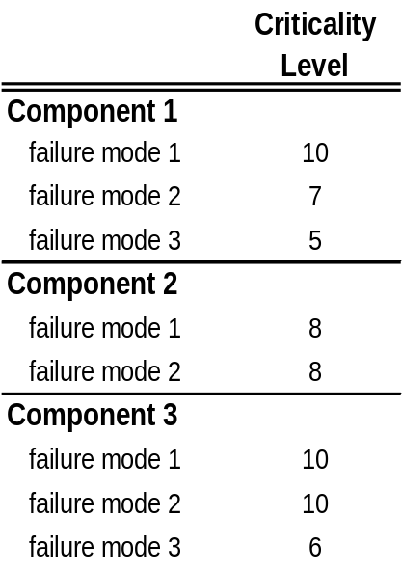
Risk Matrix
Identify Major Technical Risk Areas
risks
First, the critical technical risks or failure modes are identified and categorized by product component. Groups of components can also have additional risks or failure modes.
Component 3
Component 1
Component 2
Each risk is assigned a weighting factor (0 to 10) based on its criticality and relative importance to component performance.
0
1
2
3
4
5
6
7
8
9
10
several alternative designs or workarounds exist
an alternative design is likely, failure is not catastrophic
single-string component, product fails if this mode occurs, no known workarounds
Each component or component group can also weighted by its relative importance to product success.

Slide 3
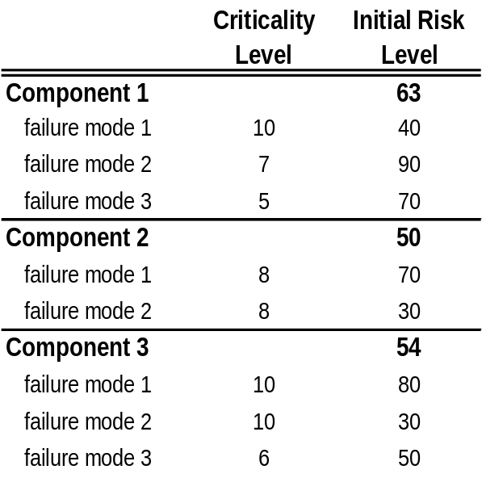
Risk Matrix
Assign Initial Risk Levels
An initial, absolute level (0 to 100) is assigned to each risk based on level of confidence in preventing the failure mode at a manufacturing level.
0
25
50
75
100
key employee has demonstrated elsewhere
not demonstrated by anyone, anywhere
demonstrated in-house; manufacturing steps known
demonstrated by others elsewhere
The total initial level of risk of a component is the weighted average of the risk levels of the failure modes.

Slide 4
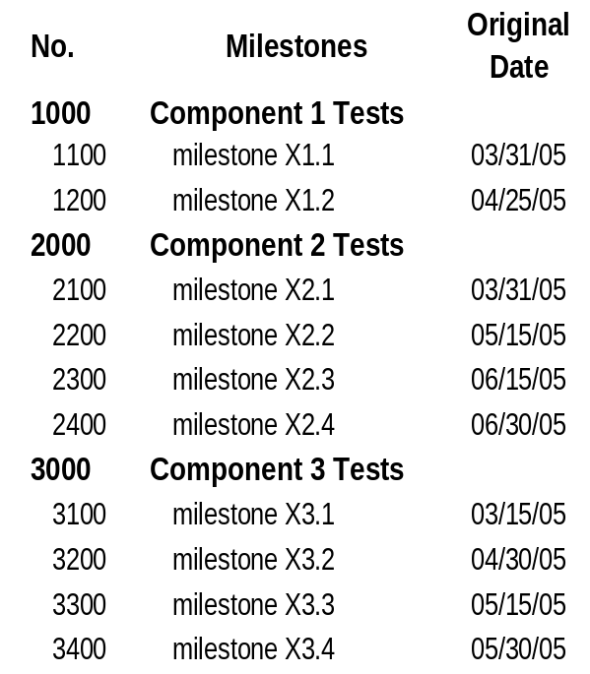
Risk Matrix
Milestone Schedule
Major project milestones (from Gantt chart) are listed.
Each milestone is expected to reduce risk in one or more categories.

Slide 5
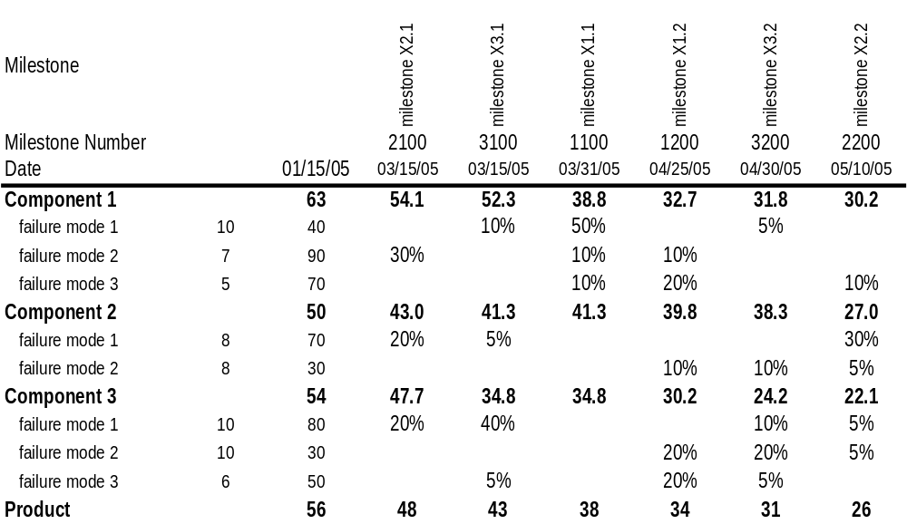
Risk Matrix
Risks and Milestones
Risks and milestones are laid out in a matrix. Each milestone reduces the risk of a particular failure mode by some percentage.
When a milestone is achieved, the absolute risk associated with a component falls.
This translates into a reduction in the overall product risk (average of all component risks)

Slide 6
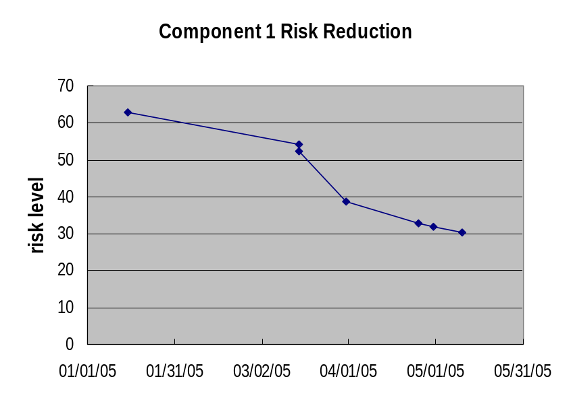
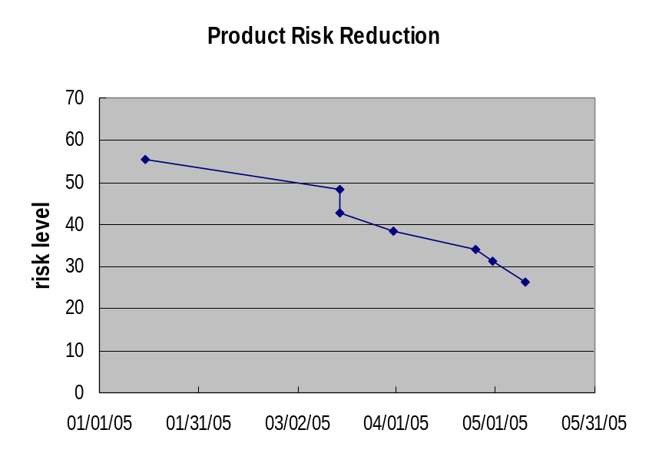
Risk Matrix
Charts
For any component (and for Product Risk), Risk Reduction can be plotted vs time and milestones.
Expenditures might also be plotted versus time on the same charts.

Slide 7
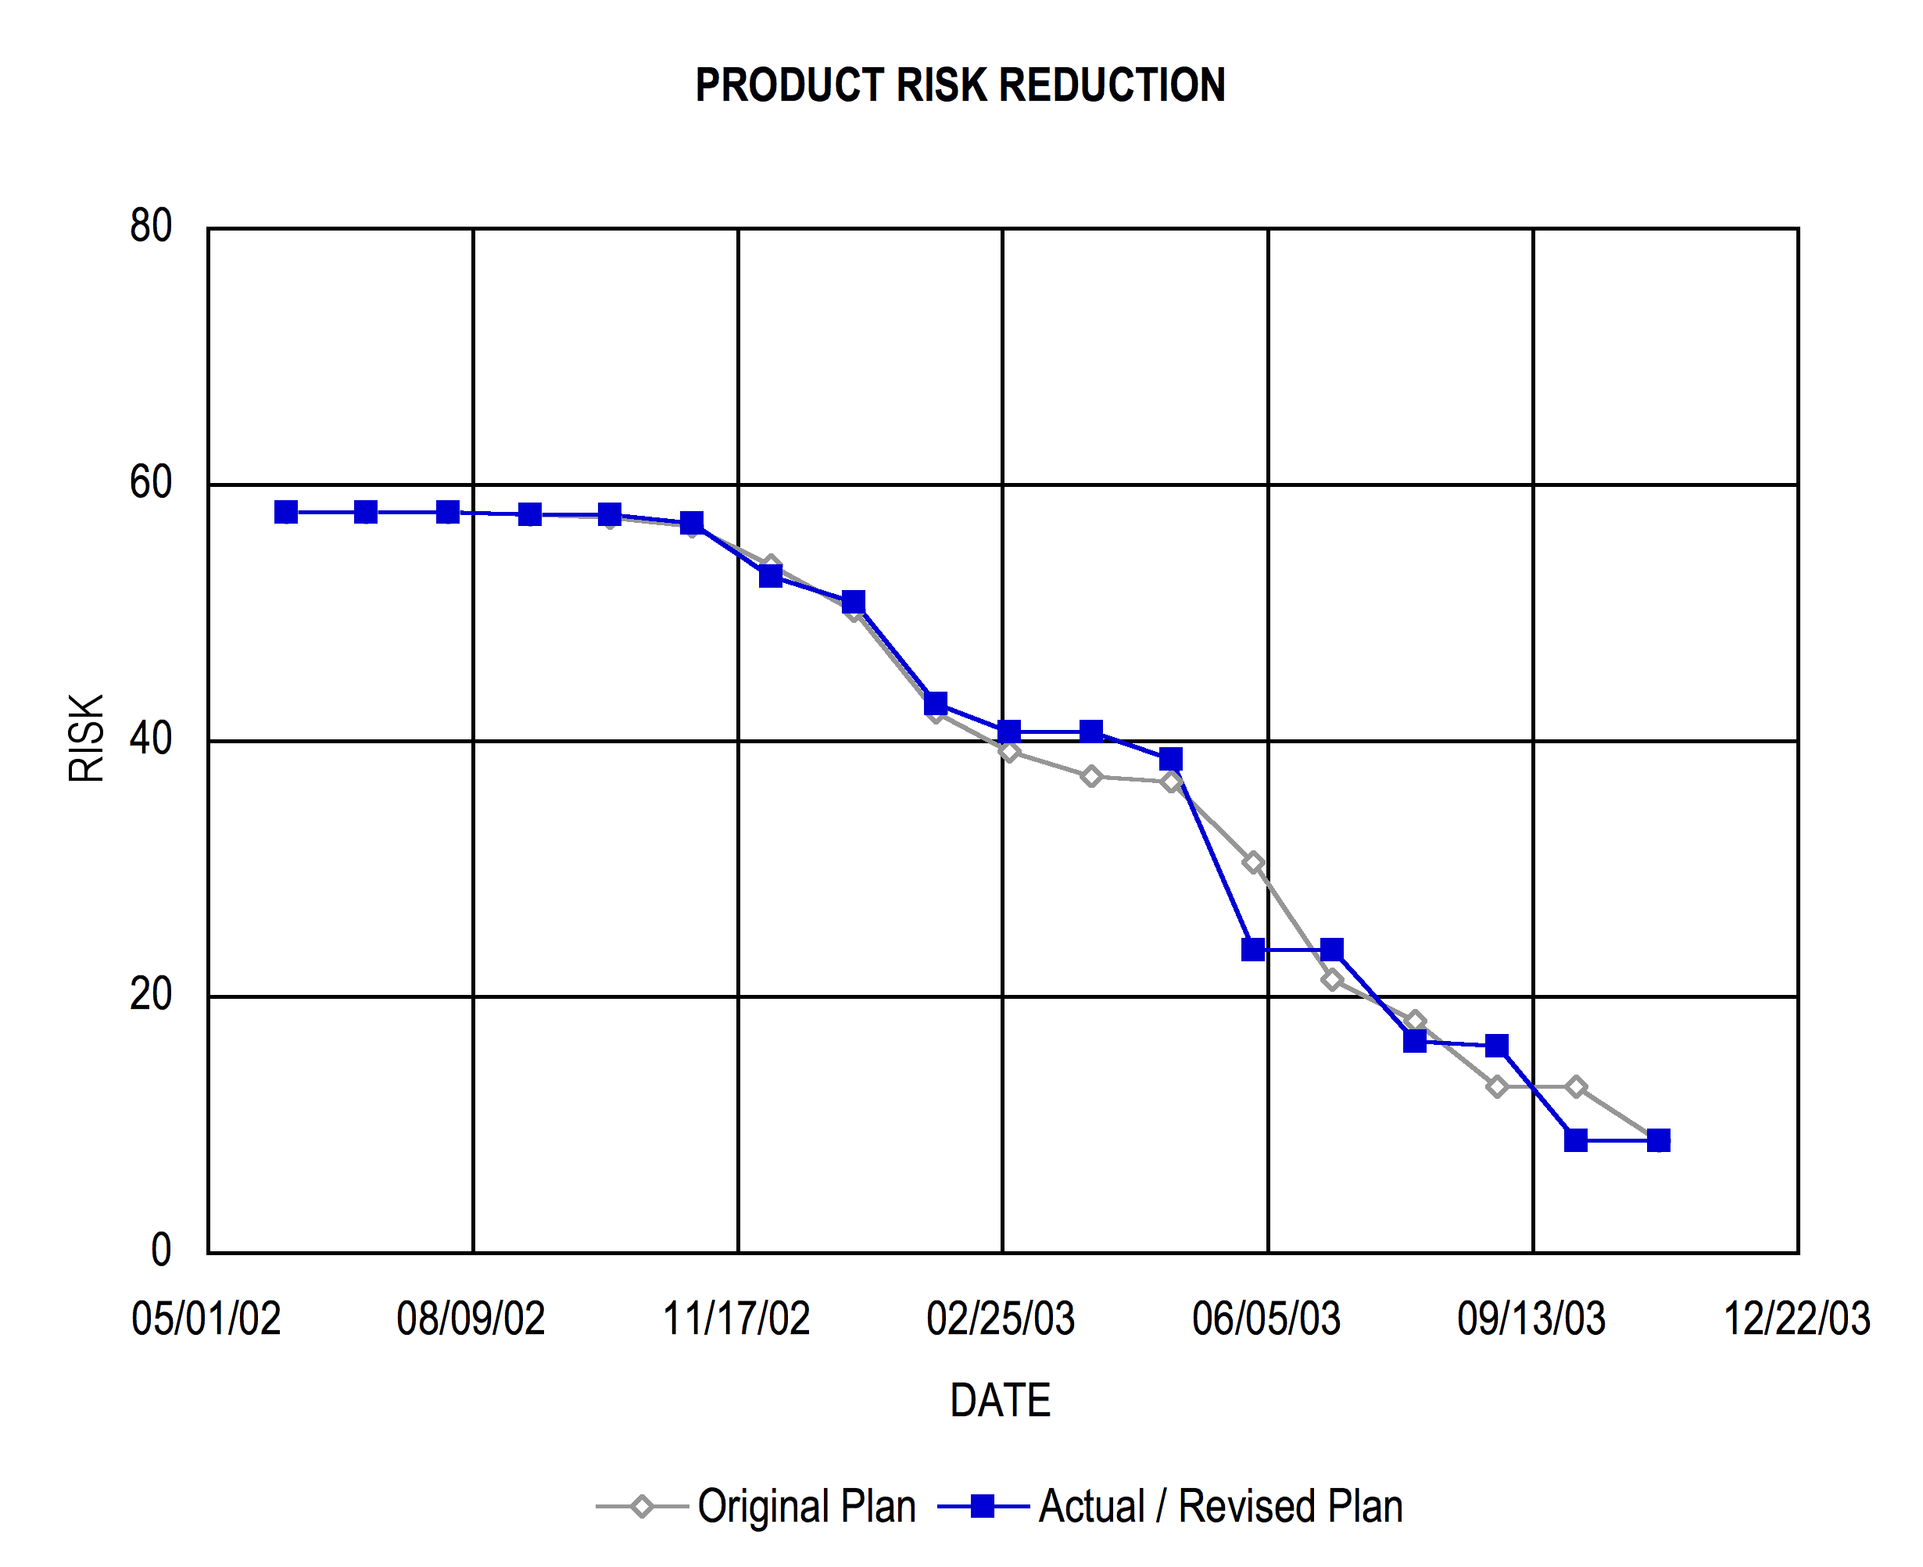
Risk Matrix
Example from an Actual Project

